Slide 1

Scheduling
7
Operating Systems: A Modern Perspective, Chapter 7

Slide 2
Scheduling
CPU scheduling refers to the task of managing CPU sharing among a community of ready processes
Real life example: room scheduler
Mechanism: Hardware and process manager’s data structure and algorithms implement the mechanism
Policy : scheduling policies are implemented as part of OS

Slide 3
Model of Process Execution
Preemption or voluntary yield
New
Process
Ready
List
Scheduler
CPU
Done
job
job
“Running”
job
“Ready”
Resource
Manager
Allocate
Request
job
job
“Blocked”
Resources
Operating Systems: A Modern Perspective, Chapter 7

Slide 4
Scheduling
In a single CPU system, only one process at a time can use the CPU. There can be only one process in the running state at a time.
The running process may cease using the CPU for any of the 4 reasons
  The process completes its execution and leaves the system
  The process requests a resource, but the resource manager decides that it cannot allocate the resource to the process
  The process decides to voluntarily release the CPU and return to the ready state
  The process involuntarily releases the CPU because the system decides to pre-empt
Operating Systems: A Modern Perspective, Chapter 7

Slide 5
Scheduler as CPU Resource Manager
Ready List
Scheduler
Ready
to run
Release
Dispatch
Release
Dispatch
Release
Process
Dispatch
Units of time for a
time-multiplexed CPU
Operating Systems: A Modern Perspective, Chapter 7

Slide 6
The Scheduler
From
Other
States
Process
Descriptor
Ready Process
Enqueuer
Ready
List
Dispatcher
Context
Switcher
CPU
Running Process
Operating Systems: A Modern Perspective, Chapter 7

Slide 7
The scheduler
Scheduling mechanism is composed of several different parts. The logical part is incorporated into every scheduler
  The enqueuer
  The dispatcher
  The context switcher
Operating Systems: A Modern Perspective, Chapter 7

Slide 8
When a process is changed to ready state, its descriptor is updated to reflect the change and the enqueuer component places a pointer to the descriptor into a list of processes that are waiting for the CPU.
When the scheduler switches the CPU from executing another, the context switcher components saves the contents of all CPU registers for the process being removed from the CPU in its descriptor
Dispatcher is invoked after the application process has been removed from the CPU. The dispatcher selects one of the ready process from the ready list and then allocates the CPU to that proces.
Operating Systems: A Modern Perspective, Chapter 7

Slide 9
Saving the context
Whenever the CPU is multiplexed, the old process is removed from the CPU and a new process is installed to begin using the CPU.
The CPU contains various registers that hold data and status relevant to the currently executing process.
When ever a CPU execution is paused, the contents of all the CPU registers must be saved in that process’s descriptors so that just before the process resumes execution , those register contents can be copied back into the physical CPU registers
Operating Systems: A Modern Perspective, Chapter 7

Slide 10
Saving the context
Context switching can significantly affect the performance, since modern computers have lot of general purpose & status registers to be saved.
Each context requires,
  (n+m)*b *K time units
  To save the stauts of n gen registers and m status registers, assuming b operations are required to save a single register and each store instruction requires K time units
Operating Systems: A Modern Perspective, Chapter 7

Slide 11
Process/Thread Context
Right Operand
Left Operand
Status
Registers
R1
R2
. . .
Rn
Functional Unit
ALU
Result
PC
Ctl Unit
IR
Operating Systems: A Modern Perspective, Chapter 7

Slide 12
Context Switching
Old process
Descriptor
CPU
New process Descriptor
Operating Systems: A Modern Perspective, Chapter 7

Slide 13
n=32, m=8, b*K =50ns
(n+m)*b*K = 2 microseconds
4 microsec for both restoring and loading
A 1 GHz processor can execute a register instruction in about 2 nano seconds
The processor could execute 2000 instructions during useful work
So the cost of context switching is a significant factor in CPU multiplexing
Operating Systems: A Modern Perspective, Chapter 7

Slide 14
Pre-emptive &non pre-emptive kernels
A scheduler that uses voluntary CPU sharing is called a non-preemptive scheduler
A scheduler that uses involuntary CPU sharing is called pre-emptive scheduler
Operating Systems: A Modern Perspective, Chapter 7

Slide 15
Contemporary Scheduling
Involuntary CPU sharing – timer interrupts
  Time quantum determined by interval timer – usually fixed size for every process using the system
  Sometimes called the time slice length
Operating Systems: A Modern Perspective, Chapter 7

Slide 16
Choosing a Process to Run
Ready Process
Process
Descriptor
Enqueue
Ready
List
Dispatch
Context
Switch
CPU
Running Process
Mechanism never changes
Strategy = policy the dispatcher uses to select a process from the ready list
Different policies for different requirements
Operating Systems: A Modern Perspective, Chapter 7

Slide 17
Policy Considerations
The CPU scheduling is remarkably similar to other types of scheduling that have been studied for years.
CPU can be thought of as a teller in a bank, where processes are customers
Policy can control/influence:
  CPU utilization
  Average time a process waits for service
  Average amount of time to complete a job
Operating Systems: A Modern Perspective, Chapter 7

Slide 18
Model of Process Execution
Preemption or voluntary yield
New
Process
Ready
List
Scheduler
CPU
Done
job
job
“Running”
job
“Ready”
Resource
Manager
Allocate
Request
job
job
“Blocked”
Resources
Operating Systems: A Modern Perspective, Chapter 7

Slide 19
A model to study scheduling
Operating Systems: A Modern Perspective, Chapter 7

Slide 20
Commonly used performance matrics
Let P = {p_{i} | 0 ≤ i < n} = set of processes
Let S(p_{i}) ∈ {running, ready, blocked}
Let τ(p_{i}) = Time process needs to be in running state (the service time)
Let W(p_{i}) = Time p_{i} is in ready state before first transition to running (wait time)
Let T_{TRnd}(p_{i}) = Time from p_{i} first enter ready to last exit ready (turnaround time)
Batch Throughput rate = inverse of avg T_{TRnd}
Timesharing response time = W(p_{i})
Operating Systems: A Modern Perspective, Chapter 7

Slide 21
Simplified Model
Preemption or voluntary yield
New
Process
Ready
List
Scheduler
CPU
Done
job
job
“Running”
job
“Ready”
Resource
Manager
Allocate
Request
job
job
“Blocked”
Resources
Simplified, but still provide analysis result
Easy to analyze performance
No issue of voluntary/involuntary sharing
Operating Systems: A Modern Perspective, Chapter 7

Slide 22
Nonpreemptive Schedulers
Blocked or preempted processes
New
Process
Ready
List
Scheduler
CPU
Done
Try to use the simplified scheduling model
Only consider running and ready states
Operating Systems: A Modern Perspective, Chapter 7

Slide 23
First-Come-First-Served
i τ(p_{i})
0 350
1 125
2 475
3 250
4 75
0
350
p₀
T_{TRnd}(p₀) = τ(p₀) = 350
W(p₀) = 0
Operating Systems: A Modern Perspective, Chapter 7

Slide 24
First-Come-First-Served
i τ(p_{i})
0 350
1 125
2 475
3 250
4 75
350
475
p₀
p₁
T_{TRnd}(p₀) = τ(p₀) = 350
T_{TRnd}(p₁) = (τ(p₁) +T_{TRnd}(p₀)) = 125+350 = 475
W(p₀) = 0
W(p₁) = T_{TRnd}(p₀) = 350
Operating Systems: A Modern Perspective, Chapter 7

Slide 25
First-Come-First-Served
i τ(p_{i})
0 350
1 125
2 475
3 250
4 75
475
950
p₀
p₁
p₂
T_{TRnd}(p₀) = τ(p₀) = 350
T_{TRnd}(p₁) = (τ(p₁) +T_{TRnd}(p₀)) = 125+350 = 475
T_{TRnd}(p₂) = (τ(p₂) +T_{TRnd}(p₁)) = 475+475 = 950
W(p₀) = 0
W(p₁) = T_{TRnd}(p₀) = 350
W(p₂) = T_{TRnd}(p₁) = 475
Operating Systems: A Modern Perspective, Chapter 7

Slide 26
First-Come-First-Served
i τ(p_{i})
0 350
1 125
2 475
3 250
4 75
950
1200
p₀
p₁
p₂
p₃
T_{TRnd}(p₀) = τ(p₀) = 350
T_{TRnd}(p₁) = (τ(p₁) +T_{TRnd}(p₀)) = 125+350 = 475
T_{TRnd}(p₂) = (τ(p₂) +T_{TRnd}(p₁)) = 475+475 = 950
T_{TRnd}(p₃) = (τ(p₃) +T_{TRnd}(p₂)) = 250+950 = 1200
W(p₀) = 0
W(p₁) = T_{TRnd}(p₀) = 350
W(p₂) = T_{TRnd}(p₁) = 475
W(p₃) = T_{TRnd}(p₂) = 950
Operating Systems: A Modern Perspective, Chapter 7

Slide 27
First-Come-First-Served
i τ(p_{i})
0 350
1 125
2 475
3 250
4 75
1200
1275
p₀
p₁
p₂
p₃
p₄
T_{TRnd}(p₀) = τ(p₀) = 350
T_{TRnd}(p₁) = (τ(p₁) +T_{TRnd}(p₀)) = 125+350 = 475
T_{TRnd}(p₂) = (τ(p₂) +T_{TRnd}(p₁)) = 475+475 = 950
T_{TRnd}(p₃) = (τ(p₃) +T_{TRnd}(p₂)) = 250+950 = 1200
T_{TRnd}(p₄) = (τ(p₄) +T_{TRnd}(p₃)) = 75+1200 = 1275
W(p₀) = 0
W(p₁) = T_{TRnd}(p₀) = 350
W(p₂) = T_{TRnd}(p₁) = 475
W(p₃) = T_{TRnd}(p₂) = 950
W(p₄) = T_{TRnd}(p₃) = 1200
Operating Systems: A Modern Perspective, Chapter 7

Slide 28
FCFS Average Wait Time
i τ(p_{i})
0 350
1 125
2 475
3 250
4 75
Easy to implement
Ignores service time, etc
Not a great performer
0
350
475
900
1200
1275
p₀
p₁
p₂
p₃
p₄
T_{TRnd}(p₀) = τ(p₀) = 350
T_{TRnd}(p₁) = (τ(p₁) +T_{TRnd}(p₀)) = 125+350 = 475
T_{TRnd}(p₂) = (τ(p₂) +T_{TRnd}(p₁)) = 475+475 = 950
T_{TRnd}(p₃) = (τ(p₃) +T_{TRnd}(p₂)) = 250+950 = 1200
T_{TRnd}(p₄) = (τ(p₄) +T_{TRnd}(p₃)) = 75+1200 = 1275
W(p₀) = 0
W(p₁) = T_{TRnd}(p₀) = 350
W(p₂) = T_{TRnd}(p₁) = 475
W(p₃) = T_{TRnd}(p₂) = 950
W(p₄) = T_{TRnd}(p₃) = 1200
W_{avg} = (0+350+475+950+1200)/5 = 2974/5 = 595
Operating Systems: A Modern Perspective, Chapter 7

Slide 29
Shortest Job Next
SJN scheduling algorithm chooses the process requiring minimum service time as the highest priority job
SJN minimizes average waiting time because it services small process before it services large ones.
Even though it minimizes AWT, it may penalize process with high service time requests.
Arrival order is irrelevant here
Operating Systems: A Modern Perspective, Chapter 7

Slide 30
Shortest Job Next
i τ(p_{i})
0 350
1 125
2 475
3 250
4 75
0
75
p₄
T_{TRnd}(p₄) = τ(p₄) = 75
W(p₄) = 0
Operating Systems: A Modern Perspective, Chapter 7

Slide 31
Shortest Job Next
i τ(p_{i})
0 350
1 125
2 475
3 250
4 75
0
75
200
p₄
p₁
T_{TRnd}(p₁) = τ(p₁)+τ(p₄) = 125+75 = 200
T_{TRnd}(p₄) = τ(p₄) = 75
W(p₁) = 75
W(p₄) = 0
Operating Systems: A Modern Perspective, Chapter 7

Slide 32
Shortest Job Next
i τ(p_{i})
0 350
1 125
2 475
3 250
4 75
0
75
200
450
p₄
p₁
p₃
T_{TRnd}(p₁) = τ(p₁)+τ(p₄) = 125+75 = 200
T_{TRnd}(p₃) = τ(p₃)+τ(p₁)+τ(p₄) = 250+125+75 = 450
T_{TRnd}(p₄) = τ(p₄) = 75
W(p₁) = 75
W(p₃) = 200
W(p₄) = 0
Operating Systems: A Modern Perspective, Chapter 7

Slide 33
Shortest Job Next
i τ(p_{i})
0 350
1 125
2 475
3 250
4 75
0
75
200
450
800
p₄
p₁
p₃
p₀
T_{TRnd}(p₀) = τ(p₀)+τ(p₃)+τ(p₁)+τ(p₄) = 350+250+125+75 = 800
T_{TRnd}(p₁) = τ(p₁)+τ(p₄) = 125+75 = 200
T_{TRnd}(p₃) = τ(p₃)+τ(p₁)+τ(p₄) = 250+125+75 = 450
T_{TRnd}(p₄) = τ(p₄) = 75
W(p₀) = 450
W(p₁) = 75
W(p₃) = 200
W(p₄) = 0
Operating Systems: A Modern Perspective, Chapter 7

Slide 34
Shortest Job Next
i τ(p_{i})
0 350
1 125
2 475
3 250
4 75
0
75
200
450
800
1275
p₄
p₁
p₃
p₀
p₂
T_{TRnd}(p₀) = τ(p₀)+τ(p₃)+τ(p₁)+τ(p₄) = 350+250+125+75 = 800
T_{TRnd}(p₁) = τ(p₁)+τ(p₄) = 125+75 = 200
T_{TRnd}(p₂) = τ(p₂)+τ(p₀)+τ(p₃)+τ(p₁)+τ(p₄) = 475+350+250+125+75
= 1275
T_{TRnd}(p₃) = τ(p₃)+τ(p₁)+τ(p₄) = 250+125+75 = 450
T_{TRnd}(p₄) = τ(p₄) = 75
W(p₀) = 450
W(p₁) = 75
W(p₂) = 800
W(p₃) = 200
W(p₄) = 0
Operating Systems: A Modern Perspective, Chapter 7

Slide 35
Shortest Job Next
i τ(p_{i})
0 350
1 125
2 475
3 250
4 75
Minimizes wait time
May starve large jobs
Must know service times
0
75
200
450
800
1275
p₄
p₁
p₃
p₀
p₂
T_{TRnd}(p₀) = τ(p₀)+τ(p₃)+τ(p₁)+τ(p₄) = 350+250+125+75 = 800
T_{TRnd}(p₁) = τ(p₁)+τ(p₄) = 125+75 = 200
T_{TRnd}(p₂) = τ(p₂)+τ(p₀)+τ(p₃)+τ(p₁)+τ(p₄) = 475+350+250+125+75
= 1275
T_{TRnd}(p₃) = τ(p₃)+τ(p₁)+τ(p₄) = 250+125+75 = 450
T_{TRnd}(p₄) = τ(p₄) = 75
W(p₀) = 450
W(p₁) = 75
W(p₂) = 800
W(p₃) = 200
W(p₄) = 0
W_{avg} = (450+75+800+200+0)/5 = 1525/5 = 305
Operating Systems: A Modern Perspective, Chapter 7

Slide 36
If the ready list is saturated, then the process with large service time tend to be left in the ready list while small process receive service.
In extreme case, process with larger service time will never be served
This starvation of large process can be serious liability of the scheduling algorithm
Operating Systems: A Modern Perspective, Chapter 7

Slide 37
Priority scheduling
In this, process are allocated to the CPU on the basis of an externally assigned priority
A process external priority is determined from the abitrary criteria(user identification, nature of the work etc)
Policies
  Static priority : computed once
  Dynamic priority : process to become more or less important depending on how much service it has recently recieved
Operating Systems: A Modern Perspective, Chapter 7
Operating Systems: A Modern Perspective, Chapter 7

Slide 38
Priority scheduling
Static priority may cause low priority processs to starve
This can be addressed by using dynamic priorities
Operating Systems: A Modern Perspective, Chapter 7

Slide 39
Priority Scheduling
i τ(p_{i}) Pri
0 350 5
1 125 2
2 475 3
3 250 1
4 75 4
Reflects importance of external use
May cause starvation
Can address starvation with aging
0
250
375
850
925
1275
p₃
p₁
p₂
p₄
p₀
T_{TRnd}(p₀) = τ(p₀)+τ(p₄)+τ(p₂)+τ(p₁) )+τ(p₃) = 350+75+475+125+250
= 1275
T_{TRnd}(p₁) = τ(p₁)+τ(p₃) = 125+250 = 375
T_{TRnd}(p₂) = τ(p₂)+τ(p₁)+τ(p₃) = 475+125+250 = 850
T_{TRnd}(p₃) = τ(p₃) = 250
T_{TRnd}(p₄) = τ(p₄)+ τ(p₂)+ τ(p₁)+τ(p₃) = 75+475+125+250 = 925
W(p₀) = 925
W(p₁) = 250
W(p₂) = 375
W(p₃) = 0
W(p₄) = 850
W_{avg} = (925+250+375+0+850)/5 = 2400/5 = 480
Operating Systems: A Modern Perspective, Chapter 7

Slide 40
Deadline Scheduling
Hard real time systems are often characterized as having certain process that must complete execution prior to some time deadline
The critical performance measure is whether the system will be able to meet all such process’s scheduling deadlines.
Measure of turnaround time and wait time are irrelevant here
Operating Systems: A Modern Perspective, Chapter 7

Slide 41
As a result, these schedulers require complete knowledge of maximum service time for each process
Eg: in streaming media systems, dead line required to prevent jitter and latency in audio or video processing
Earliest deadline first scheduling (EDFS) is an optimal algorithm for certain types of deadline scheduling.
Operating Systems: A Modern Perspective, Chapter 7

Slide 42
Deadline Scheduling
i τ(p_{i}) Deadline
0 350 575
1 125 550
2 475 1050
3 250 (none)
4 75 200
Allocates service by deadline
May not be feasible
200
550
575
1050
0
1275
p₄
p₁
p₀
p₂
p₃
Operating Systems: A Modern Perspective, Chapter 7

Slide 43
Preemptive Schedulers
Preemption or voluntary yield
New
Process
Ready
List
Scheduler
CPU
Done
Highest priority process is guaranteed to be running at all times
  Or at least at the beginning of a time slice
Dominant form of contemporary scheduling
But complex to build & analyze
Operating Systems: A Modern Perspective, Chapter 7

Slide 44
Preemptive versions of SJN & priority scheduling
Preemptive versions of SJN and priority algorithms are also available
This versions differ from the nonpreemptive versions by keeping the highest priority job in the running state at all times.
If p_{i} is executing and is pre-empted by the arrival of p_{j} , then SJN need only compare τ(p_{i}) and τ(p_{j)}
Operating Systems: A Modern Perspective, Chapter 7

Slide 45
Round Robin Scheduling
RR is the most widely used of all the scheduling algorithms.
The goal of RR is equitable distribution of the processing time among all processes requesting the processor.
This distribution will tend to fit in with the multiprogramming philosophy in which each of n process receive approximately 1/n time units of processing time
Operating Systems: A Modern Perspective, Chapter 7

Slide 46
A system with a timer interrupt naturally fits with RR scheduling, since the interrupt interval can be set to the desired time quantum
When the timer interrupt occurs, the executing process’s time quantum has completed . There for scheduler removes the running process form the CPU. The scheduler then adjusts the ready queue list according the implementation, resets the timer and dispatches the process at the head of the ready list to the CPU
Operating Systems: A Modern Perspective, Chapter 7

Slide 47
Round Robin (TQ=50)
i τ(p_{i})
0 350
1 125
2 475
3 250
4 75
0
50
p₀
W(p₀) = 0
Operating Systems: A Modern Perspective, Chapter 7

Slide 48
Round Robin (TQ=50)
i τ(p_{i})
0 350
1 125
2 475
3 250
4 75
0
100
p₀
p₁
W(p₀) = 0
W(p₁) = 50
Operating Systems: A Modern Perspective, Chapter 7

Slide 49
Round Robin (TQ=50)
i τ(p_{i})
0 350
1 125
2 475
3 250
4 75
0
100
p₀
p₁
p₂
W(p₀) = 0
W(p₁) = 50
W(p₂) = 100
Operating Systems: A Modern Perspective, Chapter 7

Slide 50
Round Robin (TQ=50)
i τ(p_{i})
0 350
1 125
2 475
3 250
4 75
0
100
200
p₀
p₁
p₂
p₃
W(p₀) = 0
W(p₁) = 50
W(p₂) = 100
W(p₃) = 150
Operating Systems: A Modern Perspective, Chapter 7

Slide 51
Round Robin (TQ=50)
i τ(p_{i})
0 350
1 125
2 475
3 250
4 75
0
100
200
p₀
p₁
p₂
p₃
p₄
W(p₀) = 0
W(p₁) = 50
W(p₂) = 100
W(p₃) = 150
W(p₄) = 200
Operating Systems: A Modern Perspective, Chapter 7

Slide 52
Round Robin (TQ=50)
i τ(p_{i})
0 350
1 125
2 475
3 250
4 75
0
100
200
300
p₀
p₁
p₂
p₃
p₄
p₀
W(p₀) = 0
W(p₁) = 50
W(p₂) = 100
W(p₃) = 150
W(p₄) = 200
Operating Systems: A Modern Perspective, Chapter 7

Slide 53
Round Robin (TQ=50)
i τ(p_{i})
0 350
1 125
2 475
3 250
4 75
0
100
200
300
400
475
p₀
p₁
p₂
p₃
p₄
p₀
p₁
p₂
p₃
p₄
T_{TRnd}(p₄) = 475
W(p₀) = 0
W(p₁) = 50
W(p₂) = 100
W(p₃) = 150
W(p₄) = 200
Operating Systems: A Modern Perspective, Chapter 7

Slide 54
Round Robin (TQ=50)
i τ(p_{i})
0 350
1 125
2 475
3 250
4 75
0
100
200
300
400
475
550
p₀
p₁
p₂
p₃
p₄
p₀
p₁
p₂
p₃
p₄
p₀
p₁
T_{TRnd}(p₁) = 550
T_{TRnd}(p₄) = 475
W(p₀) = 0
W(p₁) = 50
W(p₂) = 100
W(p₃) = 150
W(p₄) = 200
Operating Systems: A Modern Perspective, Chapter 7

Slide 55
Round Robin (TQ=50)
i τ(p_{i})
0 350
1 125
2 475
3 250
4 75
0
100
200
300
400
475
550
650
p₀
p₁
p₂
p₃
p₄
p₀
p₁
p₂
p₃
p₄
p₀
p₁
p₂
p₃
650
750
850
950
p₀
p₂
p₃
p₀
p₂
p₃
T_{TRnd}(p₁) = 550
T_{TRnd}(p₃) = 950
T_{TRnd}(p₄) = 475
W(p₀) = 0
W(p₁) = 50
W(p₂) = 100
W(p₃) = 150
W(p₄) = 200
Operating Systems: A Modern Perspective, Chapter 7

Slide 56
Round Robin (TQ=50)
i τ(p_{i})
0 350
1 125
2 475
3 250
4 75
0
100
200
300
400
475
550
650
p₀
p₁
p₂
p₃
p₄
p₀
p₁
p₂
p₃
p₄
p₀
p₁
p₂
p₃
650
750
850
950
1050
p₀
p₂
p₃
p₀
p₂
p₃
p₀
p₂
p₀
T_{TRnd}(p₀) = 1100
T_{TRnd}(p₁) = 550
T_{TRnd}(p₃) = 950
T_{TRnd}(p₄) = 475
W(p₀) = 0
W(p₁) = 50
W(p₂) = 100
W(p₃) = 150
W(p₄) = 200
Operating Systems: A Modern Perspective, Chapter 7

Slide 57
Round Robin (TQ=50)
i τ(p_{i})
0 350
1 125
2 475
3 250
4 75
0
100
200
300
400
475
550
650
p₀
p₁
p₂
p₃
p₄
p₀
p₁
p₂
p₃
p₄
p₀
p₁
p₂
p₃
650
750
850
950
1050
1150
1250
1275
p₀
p₂
p₃
p₀
p₂
p₃
p₀
p₂
p₀
p₂
p₂
p₂
p₂
T_{TRnd}(p₀) = 1100
T_{TRnd}(p₁) = 550
T_{TRnd}(p₂) = 1275
T_{TRnd}(p₃) = 950
T_{TRnd}(p₄) = 475
W(p₀) = 0
W(p₁) = 50
W(p₂) = 100
W(p₃) = 150
W(p₄) = 200
Operating Systems: A Modern Perspective, Chapter 7

Slide 58
Round Robin (TQ=50)
i τ(p_{i})
0 350
1 125
2 475
3 250
4 75
Equitable
Most widely-used
Fits naturally with interval timer
0
100
200
300
400
475
550
650
p₀
p₁
p₂
p₃
p₄
p₀
p₁
p₂
p₃
p₄
p₀
p₁
p₂
p₃
650
750
850
950
1050
1150
1250
1275
p₀
p₂
p₃
p₀
p₂
p₃
p₀
p₂
p₀
p₂
p₂
p₂
p₂
T_{TRnd}(p₀) = 1100
T_{TRnd}(p₁) = 550
T_{TRnd}(p₂) = 1275
T_{TRnd}(p₃) = 950
T_{TRnd}(p₄) = 475
W(p₀) = 0
W(p₁) = 50
W(p₂) = 100
W(p₃) = 150
W(p₄) = 200
T_{TRnd}__{avg} = (1100+550+1275+950+475)/5 = 4350/5 = 870
W_{avg} = (0+50+100+150+200)/5 = 500/5 = 100
Operating Systems: A Modern Perspective, Chapter 7

Slide 59
The wait times illustrates the obvious benefit of RR in terms of how quickly a process begins to receive service.
Consider the effect of context switching time on RR scheduling. Let C be the time to perform a context switch between user processes. Each of n processes will receive q units of time on the CPU for every n*(q+C) units of real time.
Operating Systems: A Modern Perspective, Chapter 7

Slide 60
RR with Overhead=10 (TQ=50)
i τ(p_{i})
0 350
1 125
2 475
3 250
4 75
Overhead must be considered
0
120
240
360
480
540
575
635
670
790
p₀
p₁
p₂
p₃
p₄
p₀
p₁
p₂
p₃
p₄
p₀
p₁
p₂
p₃
790
910
1030
1150
1270
1390
1510
1535
p₀
p₂
p₃
p₀
p₂
p₃
p₀
p₂
p₀
p₂
p₂
p₂
p₂
T_{TRnd}(p₀) = 1320
T_{TRnd}(p₁) = 660
T_{TRnd}(p₂) = 1535
T_{TRnd}(p₃) = 1140
T_{TRnd}(p₄) = 565
W(p₀) = 0
W(p₁) = 60
W(p₂) = 120
W(p₃) = 180
W(p₄) = 240
T_{TRnd}__{avg} = (1320+660+1535+1140+565)/5 = 5220/5 = 1044
W_{avg} = (0+60+120+180+240)/5 = 600/5 = 120
Operating Systems: A Modern Perspective, Chapter 7

Slide 61
Multiple Level Queues
They are an extension of priority scheduling in which all processes of the same priority are placed in a single pool.
The scheduler allocates the CPU across processes in priority pools using one strategy and allocates the CPU to processes in the same queue according to the second strategy
Operating Systems: A Modern Perspective, Chapter 7

Slide 62
Multi-Level Queues
Preemption or voluntary yield
Ready List₀
New
Process
Ready List₁
Scheduler
CPU
Done
Ready List₂
All processes at level i run before
any process at level j
At a level, use another policy, e.g. RR
Ready List₃
Operating Systems: A Modern Perspective, Chapter 7

Slide 63
Multi level feed back queue
A system that allows processes to change ready sub lists is called a multilevel feedback queue
Eg: an interrupt handler process might run at priority 1. device driver at 2, interactive process at 3, interacting editing job at 4, normal batch job at 5, long batch job at 6
If in this choice, priority of a process change dynamically during execution, depending on the phase of the execution they are currently executing
If an interactive editing processes became computation-intensive process, its priority might be dropped to a lower level, since it is attempting to use an extra share of CPU

Slide 64
Categories of Scheduling Algorithms
Batch (accounts receivable, payroll…..)
Interactive
Real time (deadlines)
Depends on the use to which the CPU is being put
Tanenbaum, Modern Operating Systems 3 e, (c) 2008 Prentice-Hall, Inc. All rights reserved. 0-13-6006639

Slide 65
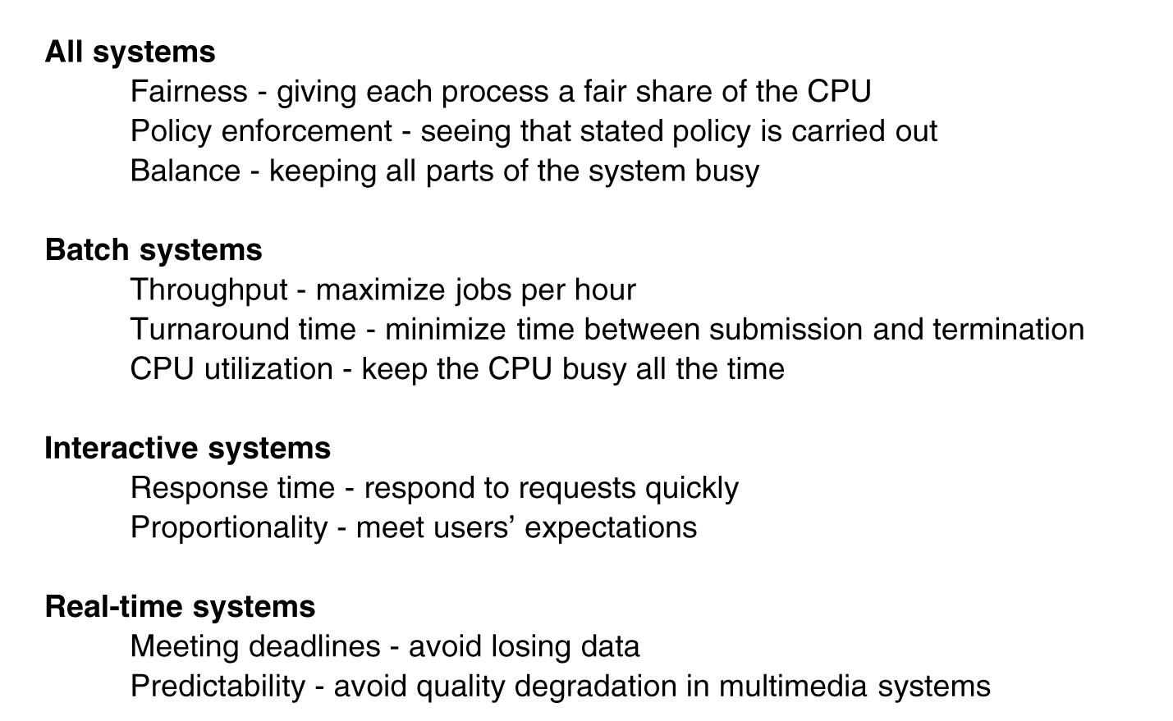
Scheduling Algorithm Goals
Tanenbaum, Modern Operating Systems 3 e, (c) 2008 Prentice-Hall, Inc. All rights reserved. 0-13-6006639

Slide 66
Scheduling in Batch Systems
First-come first-served
Shortest job first
Shortest remaining time next
Tanenbaum, Modern Operating Systems 3 e, (c) 2008 Prentice-Hall, Inc. All rights reserved. 0-13-6006639

Slide 67
Scheduling in Interactive Systems
Round robin
Priority
Multiple Queues
Shortest Process Next
Guaranteed Scheduling
Lottery Scheduling
Fair Share Scheduling
Tanenbaum, Modern Operating Systems 3 e, (c) 2008 Prentice-Hall, Inc. All rights reserved. 0-13-6006639

Slide 68
Linux schedulers
Rotating Staircase Deadline
Staircase Deadline scheduler
Noop scheduler
CFQ (Completely Fair Queuing )
Fair-share scheduling
CFS (completely fair scheduler)
BFS
O(1) Scheduler
Operating Systems: A Modern Perspective, Chapter 7

Slide 69
Fair share scheduling
Fair scheduling is a method of assigning resources to jobs such that all jobs get, on average, an equal share of resources over time.
When there is a single job running, that job uses the entire cluster. When other jobs are submitted, tasks slots that free up are assigned to the new jobs, so that each job gets roughly the same amount of CPU time.
Operating Systems: A Modern Perspective, Chapter 7

Slide 70
O(1) Scheduler
An O(1) scheduler is a kernel scheduling design that can schedule processes within a constant amount of time, regardless of how many processes are running on the operating system.
One of the major goals of operating system designers is to minimize overhead and jitter of OS services.
In Linux, it has replaced the previously used O(n) scheduler.
Designed & implemented by Ingo Molnár
Operating Systems: A Modern Perspective, Chapter 7

Slide 71
Completely Fair Scheduler (CFS)
Con Kolivas's work with CPU scheduling, most significantly his implementation of "fair scheduling" named Rotating Staircase Deadline, inspired Ingo Molnár to develop his CFS, as a replacement for the earlier O(1) scheduler.
In contrast to the previous O(1) scheduler used in older Linux 2.6 kernels, the CFS scheduler implementation is not based on run queues. Instead, a red-black tree implements a "timeline" of future task execution. Additionally, the scheduler uses nanosecond granularity accounting, the atomic units by which an individual process' share of the CPU was allocated
Operating Systems: A Modern Perspective, Chapter 7

Slide 72
Brain Fuck Scheduler(BFS)
The Brain Fuck Scheduler (BFS) is a process scheduler designed for the Linux kernel in August 2009 as an alternative to the Completely Fair Scheduler and the O(1) scheduler.BFS was created by veteran kernel programmer Con Kolivas( Australian anaesthetist)
The objective of BFS, compared to other schedulers, is to provide a scheduler with a simpler algorithm, that does not require adjustment of heuristics or tuning parameters to tailor performance to a specific type of computation workload.
Operating Systems: A Modern Perspective, Chapter 7

Slide 73
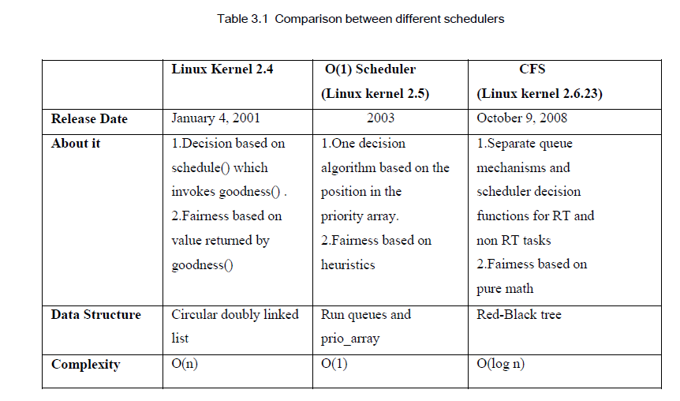
Operating Systems: A Modern Perspective, Chapter 7

Slide 74
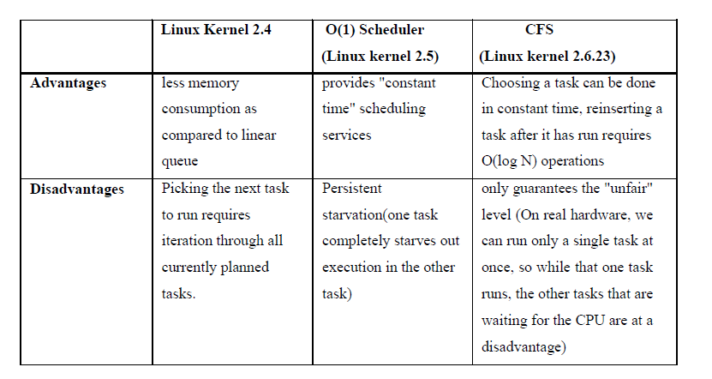
Operating Systems: A Modern Perspective, Chapter 7

